Slide 1


Smart Beach by Bruce County
for Sanjeev Kumar
Sanjeev Kumar - Professor
Brunilda Xhaferllari – Project Manager
Rich Freeman – Faculty Mentor
AI Team:
Janvi Patel
Fangji Chen
Scaria Ouseph Kurian
Date: 22-03-2023
Notes:
Image: 12019 (2016) Ocean waves crashing on shore during daytime https://pixabay.com/photos/beach-sea-sunset-sun-sunlight-1751455/

Slide 2

Additional activities since the last report
Work:
Reverse Engineering for getting better accuracy.
Implemented Crowd counting models for beach_use and station_beach data.
Labelled images for accuracy matrix.
Crowd counting models
: InsightFace
: ResNet
: YOLOv8
We have accuracy for all models of all images.
Notes:
Padrinan, Miguel (n.d.). Email blocks on Gray Surface. Accessed on January 16th, 2023 from https://www.pexels.com/photo/email-blocks-on-gray-surface-1591062/

Slide 3
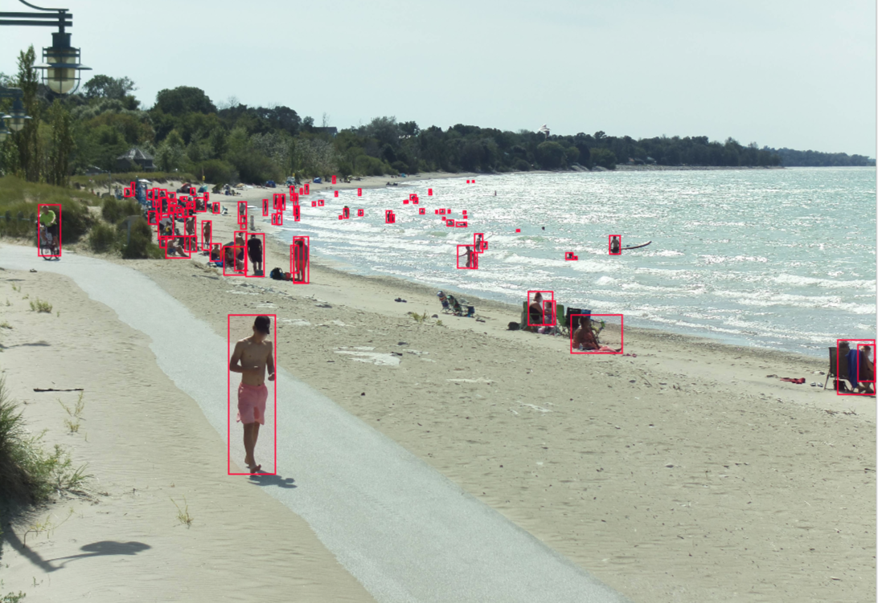
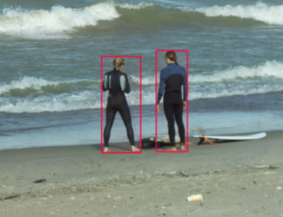
As we can see in the image we have labeled all the images first.
By which we had ground truth of all images.
After which we implemented the accuracy matrix.
Results showed which model works best for the particular image.
Based on this we can decide on classes for the training classification model.

Slide 4
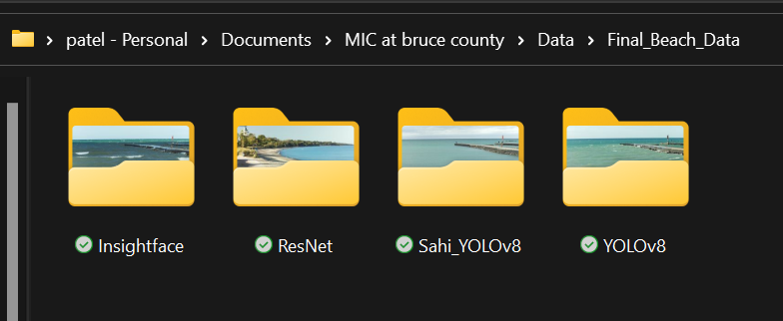
Final Data Folder Structure

Slide 5
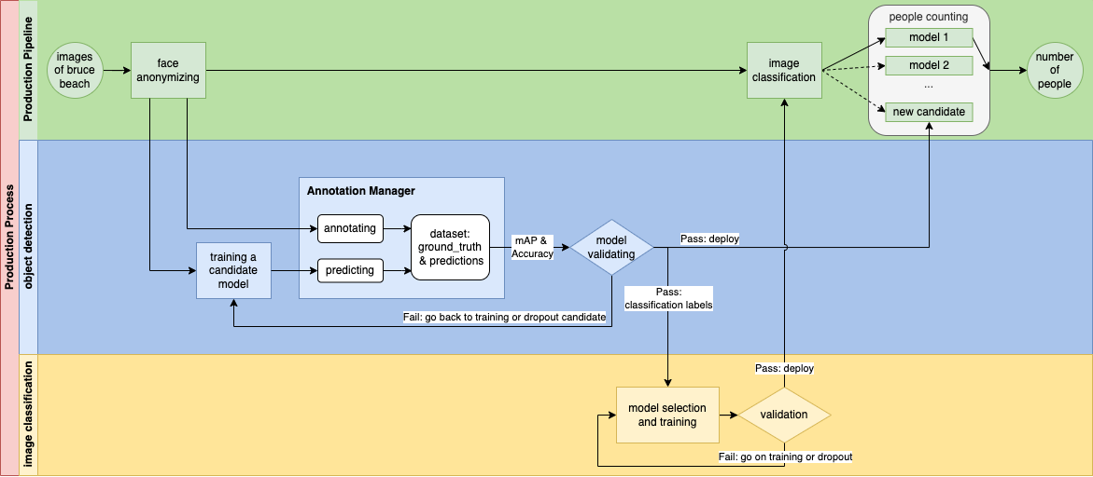

Slide 6
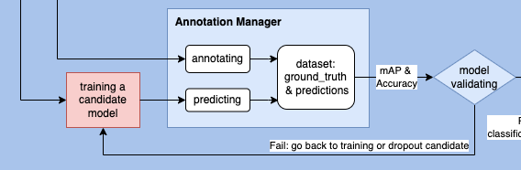
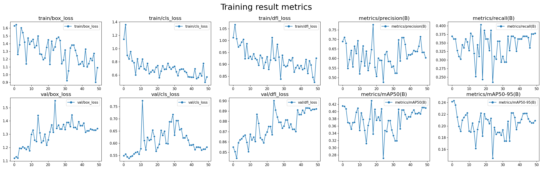
Model=YOLOv8, epochs=50, 50 epochs completed in 5.932 hours. 7.2 mins for each.

Slide 7

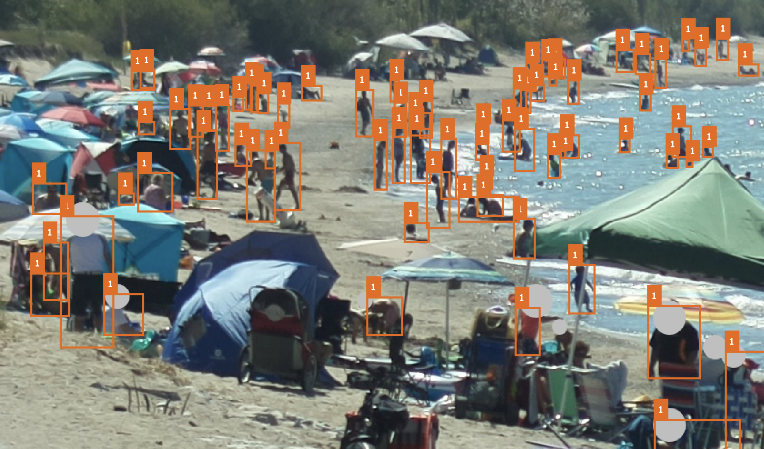
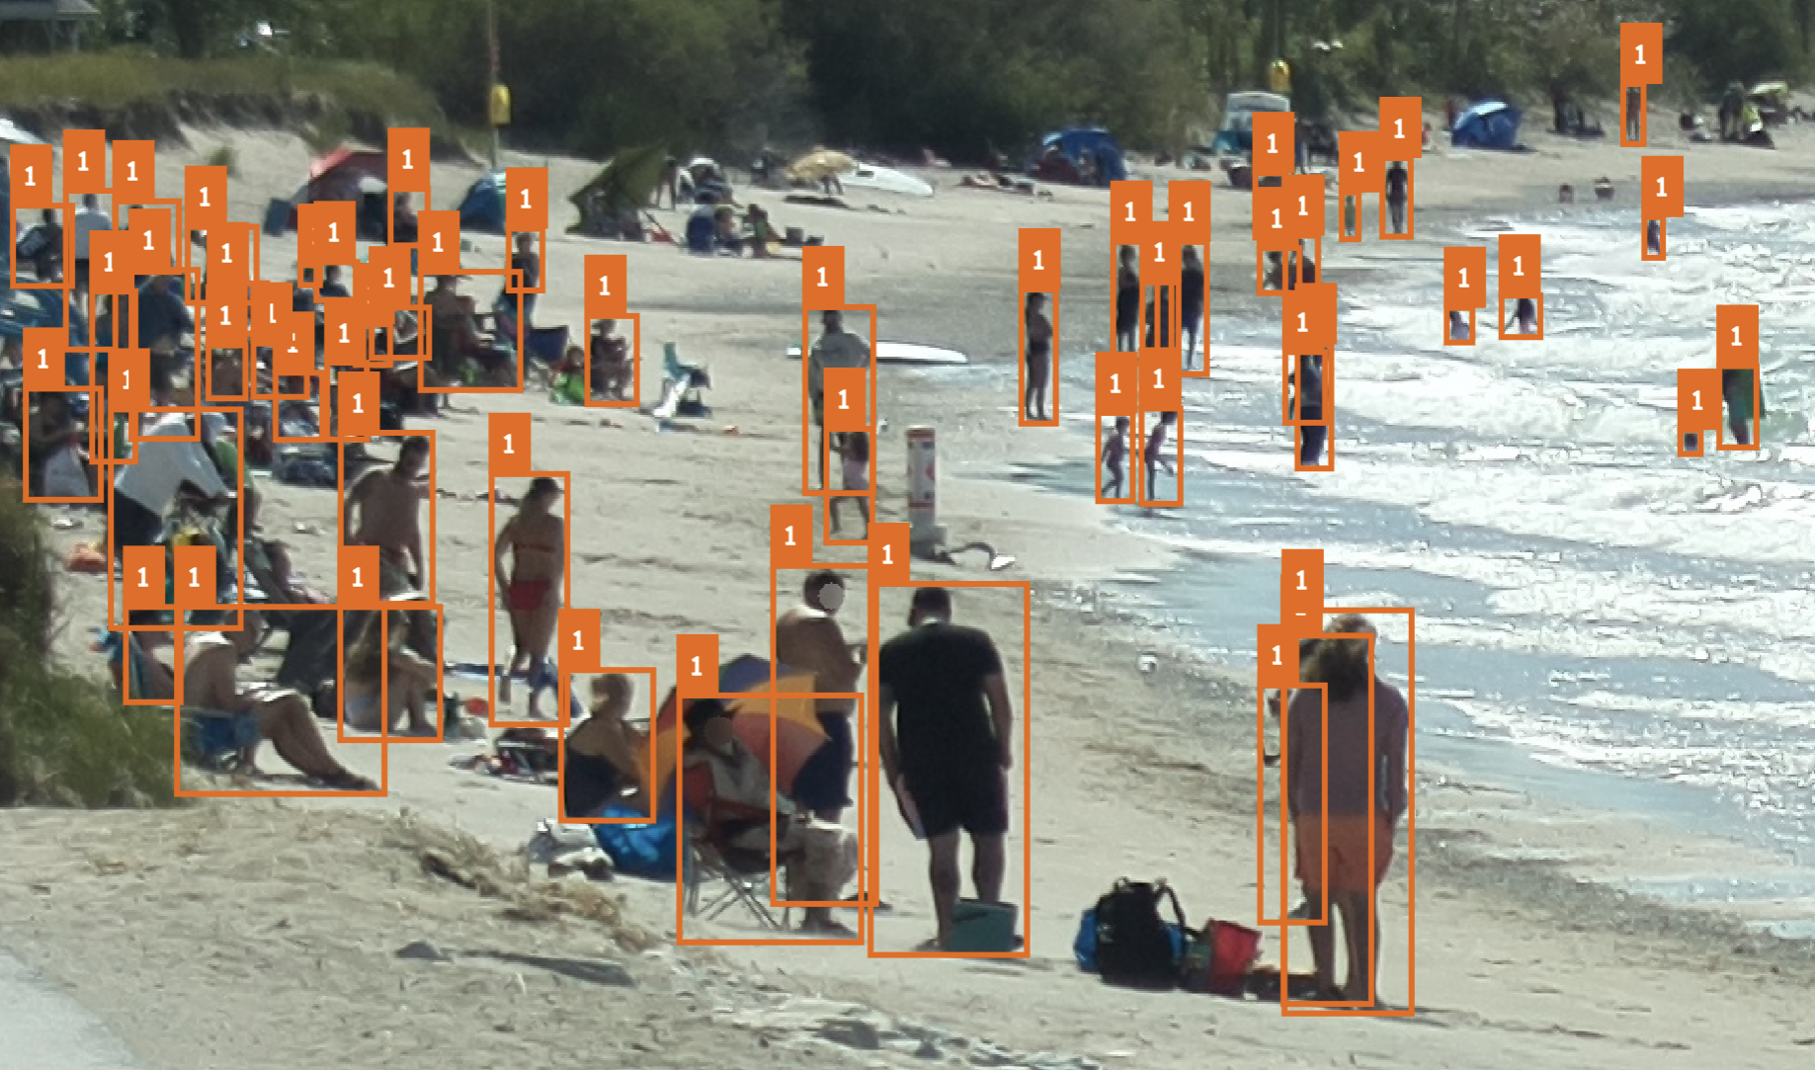
Picture3.png
2022-09-02_13-50-14.png

Slide 8
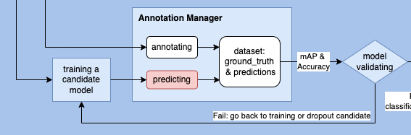
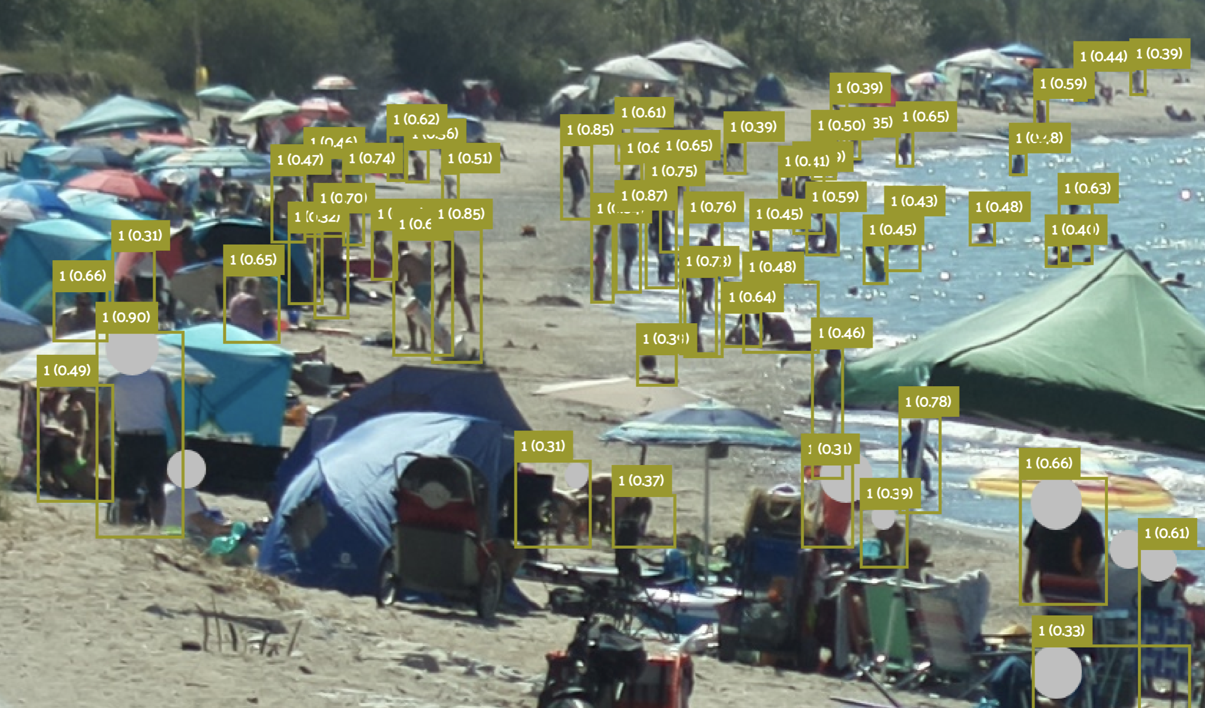
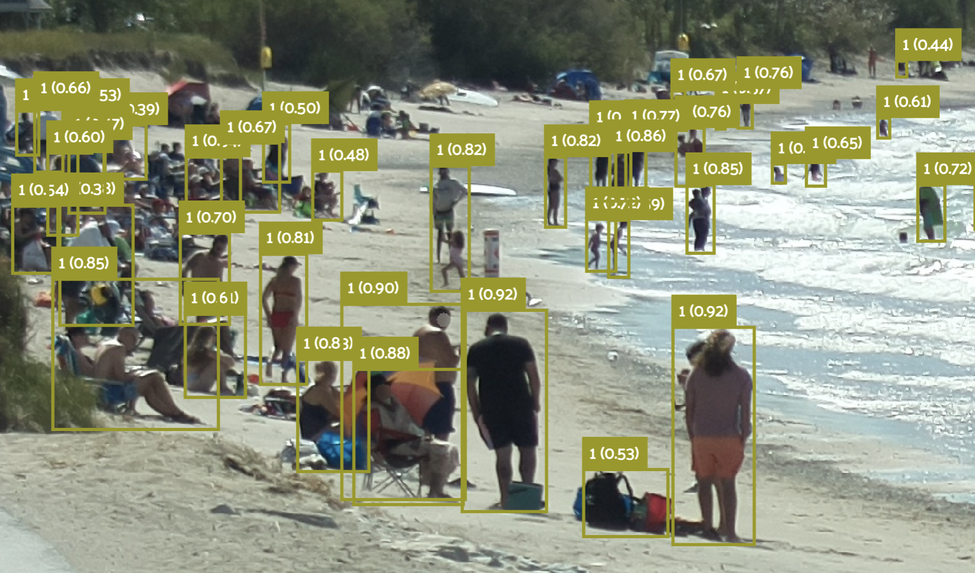
Picture3.png
2022-09-02_13-50-14.png

Slide 9
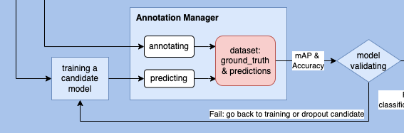
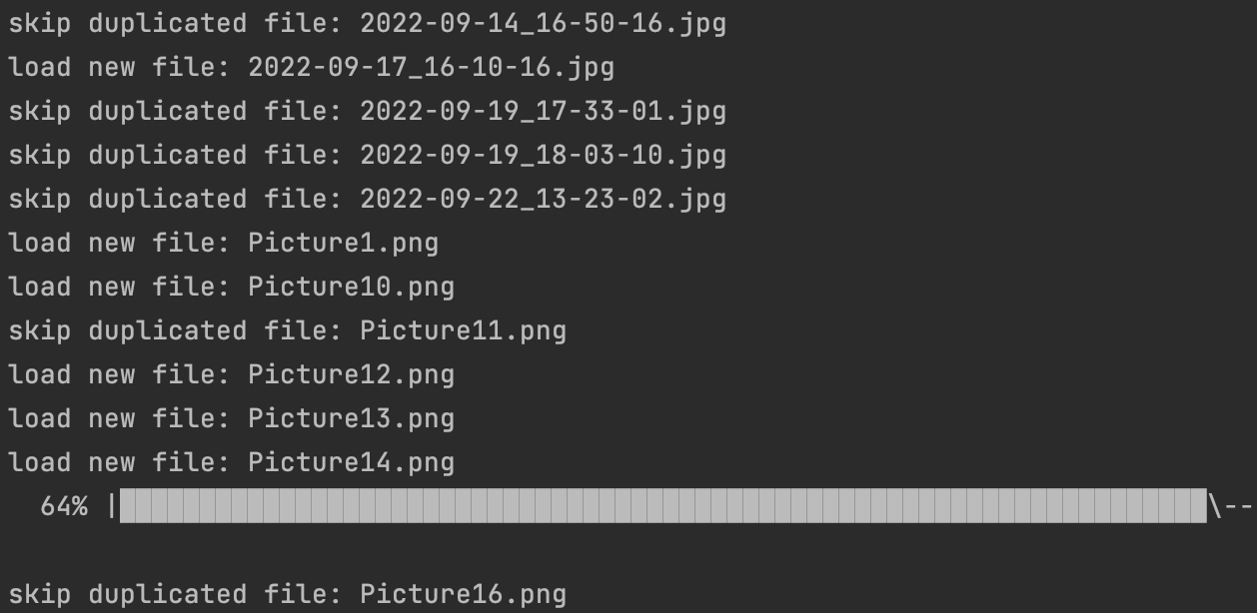
Incrementally update the ground_truth & predictions of new images

Slide 10
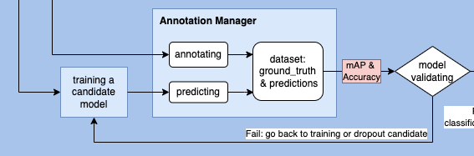
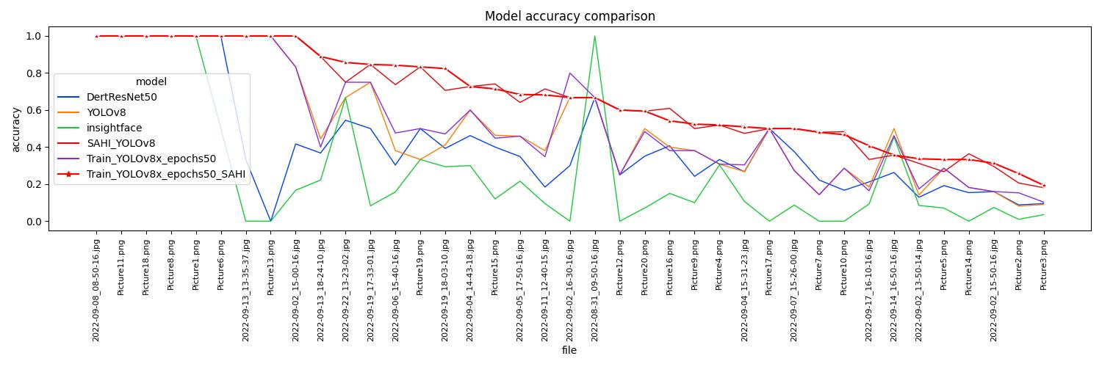

Slide 11
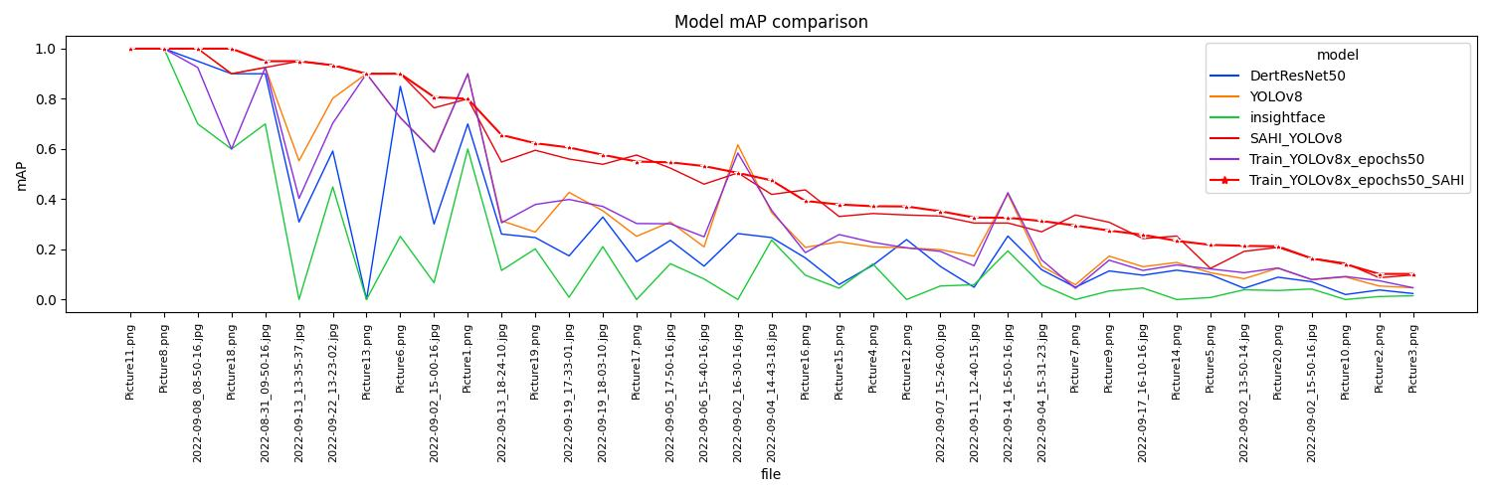

Slide 12


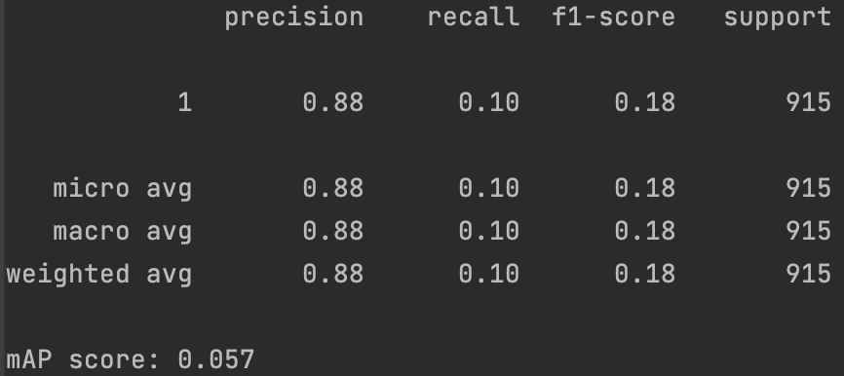
InsightFace

Slide 13
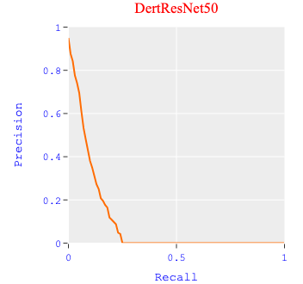
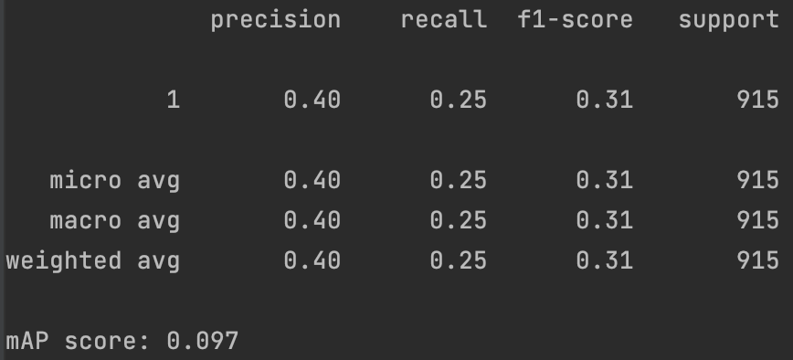
DertResNet50

Slide 14


YOLOv8

Slide 15

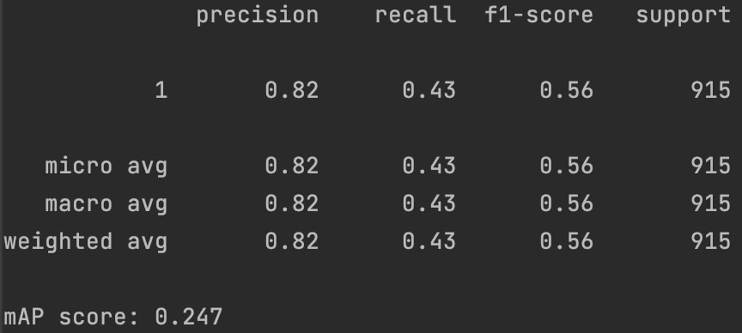
SAHI_YOLOv8

Slide 16

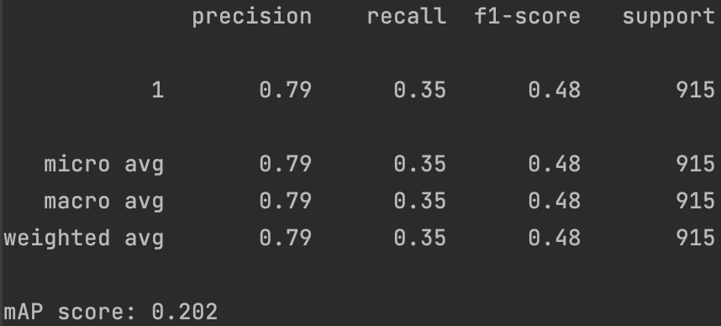
Train_YOLOv8x_epochs50

Slide 17
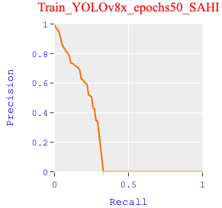
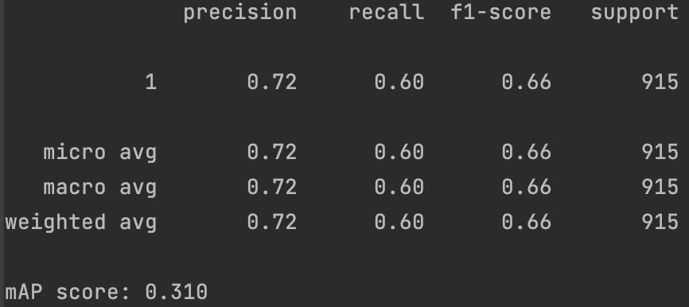
Train_YOLOv8x_epochs53_SAHI

Slide 18
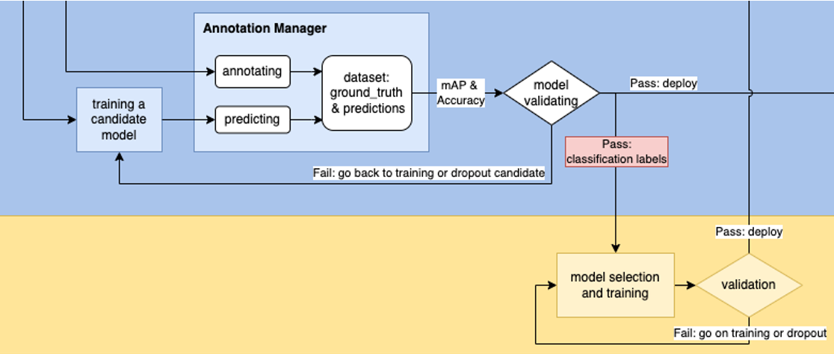
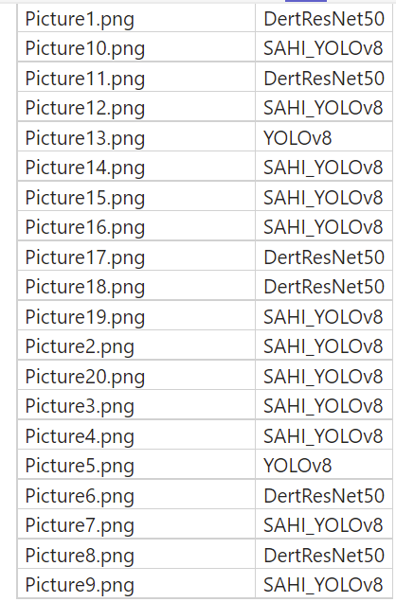
Publish the best models for each training image as a ground truth

Slide 19
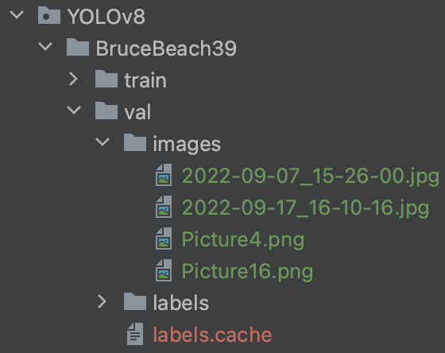
Require more training data
Only 4 images, 10% of all, can be used as validation data
SAHI + Training: this is the most desirable progress in this work
But more training data is required to train a more robust model

Slide 20
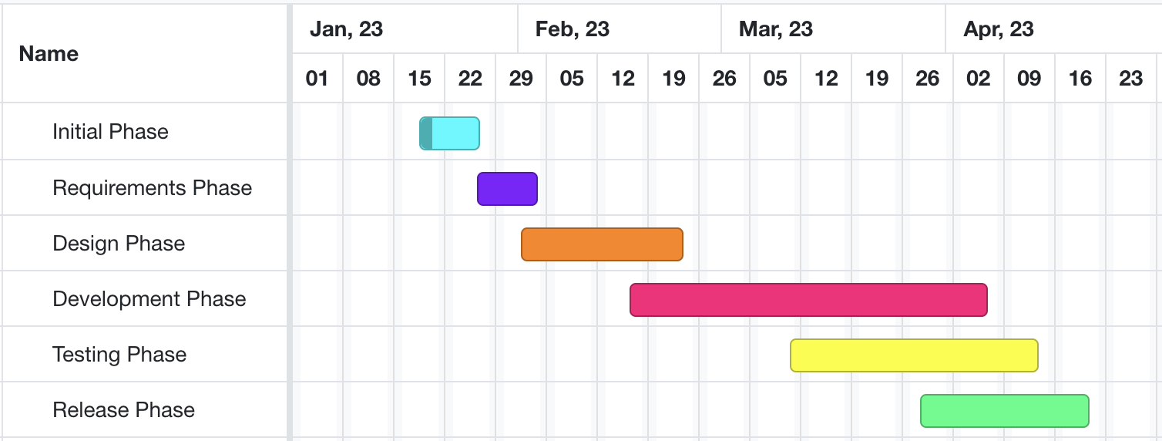
Developing and testing models on beach data
High-level GANTT Chart

Slide 21
Activities to be Completed before Next report:
Testing the models on real data.
Applying different crowd-counting models on different classes and finalizing the models for each class.
Further steps for counting the number of people in water specifically.
Final Testing of the architecture.
Notes:
Olexa, Peter (n.d.) A Person Making a Schedule. Accessed on January 18th, 2023 from https://www.pexels.com/photo/a-person-making-a-schedule-14299948/

Slide 22
Thank you!
Questions?
Notes:
Image: Leloo, The first (2022) https://www.pexels.com/photo/question-marks-on-paper-crafts-5428833/

